Slide 1


Web AppBuilder for ArcGIS Enterprise Deployments
Esri Developer Summit
March 8–11, 2016 | Palm Springs, CA
Alison Sizer and Ben Schaub
Notes:
Good afternoon
Introduce ourselves
Ben Schaub – project manager and platform architect with Esri Professional Services out of our DC Regional Office
Alison
We’re gonna spend the next hour talking about how to leverage Web AppBuilder as an application development tool within enterprise environments
With both of us working in Professional Services
We’re usually in the trenches with people like you, implementing the SW in real world scenarios, working through real world constraints
But through that we get this cool opportunity to observe and identify best practices and lessons learned that we see in orgs across all industries and all sizes

Slide 2

Agenda
Enterprise Implementation Patterns
Installation and Configuration
Application Development
Deployment
Post-Deployment
Notes:
Our goal for the next hour is to share
Share tips and tricks as well as war stories from experiences
Best practices and strategies gleaned from interacting with lots of organizations trying to accomplish the same objectives at the end of the day
We’ll start with providing an overview of enterprise options for implementing WAB
Walk through considerations for leveraging WAB within these environments throughout an implementation lifecycle

Slide 3

Enterprise…
What Does it Mean?
Notes:
FIRST, let’s level set on what we mean when we say “enterprise”
Our working definition of an enterprise GIS is a system that allows everyone in the organization to discover, create, use, and share geospatial information.
What does that mean for developers and enterprise architects?
LOTS of users
Need for an accessible, centralized environment
Integration with existing enterprise security practices that may already be entrenched within the org

Slide 4


Overview of Enterprise Implementation Patterns
Web GIS Portal Options
ArcGIS Online (Cloud, SaaS)
No SW to maintain
Automatic updates
Multi-tenant environment
Esri controls SLA
Portal for ArcGIS (On-premises)
Works in disconnected networks
Enterprise groups
Full org URL control
Org controls SLA
Desktop
Web
Device
Apps
portal
Access / Identity
Services
Server
Online Content and Services
Notes:
Implementation patterns – options available at two tiers
Web gis portal tier
WAB tier
Let’s start with the web gis portal.
- foundation for any enterprise Web GIS
For access, identity, content management
Framework for enabling a system of engagement
AGOL
Great for orgs without tools and resources to maintain a local portal infrastructure
Multi tenant
Esri responsible for service level agreement – no burden on you to ensure HA/DR
Portal
Extension to AGS
Deploy behind the firewall or
work in a completely disconnected environment. Portal can be configured to be entirely contained within org
Other added beneftis – enterprise groups, URL control, SLA/HA/COOP control (stringent)
COOP – continuity of operations
Add that these options ARE NOT mutually exclusive and that many orgs leverage both technologies in a complementary fashion

Slide 5
Overview of Enterprise Implementation Patterns
Web AppBuilder Options
Embedded Version
Fully integrated within ArcGIS Online/Portal
Fits well into the user’s workflow
No hosting server needed
Developer Edition
Required for custom components
Themes, widgets
Direct access, no need to launch from a webmap
Desktop
Web
Device
Apps
portal
Access / Identity
Services
Server
Online Content and Services
Notes:
WAB tier –two options as well
Embedded version
Ships as a core component to AGOL/Portal
Benefits
One BIG shortcoming of embedded is the inability to customize or make changes beyond the OOTB config options
For orgs who want more fine grained control –
Dev Edition
Version of WAB that is installed and deployed locally (on-premises)
Req’d for customizations – skinning (theming) to align with org style guides or feature functionality not supported OOTB
Both offer the same “builder” user experience, same capabilities

Slide 6
Overview of Enterprise Implementation Patterns
Common Enterprise Patterns
More Common
Portal for ArcGIS with Dev Edition
ArcGIS Online with Dev Edition
Portal for ArcGIS with Embedded Version
ArcGIS Online with Embedded Version
Less Common
Notes:
We’ve seen any and all combinations of web GIS portal and WAB version being leveraged in an enterprise environment.
Through our experience, we’ve seen dev edition as the more popular option within larger deployments, although I know of many orgs leveraging the embedded version as well
Most of our presentation today will focus on Dev Edition because it is more common, and is the implementation type where developers would play a larger role

Slide 7
Install/Configure
https://developers.arcgis.com/web-appbuilder/guide/getstarted.htm
Notes:
There is relatively good documentation about getting WebAppBuilder up and running in your environment at the url on this screen.
I just want to highlight here some of the things you might run into in an Enterprise installation

Slide 8


Install/Config Tips
Pointing to a local JSAPI
jsapi
or
local
Portal jsapi: http://webserver/webadaptor/jsapi/jsapi/
File location: C:\Program Files\ArcGIS\Portal\framework\jsapi
client/stemapp/env.js
Web AppBuilder
{ . . .
var apiUrl = 'http://webserver/webadaptor/jsapi/jsapi/';
. . .
}
Notes:
After you download wab, your first decision in an enterprise environment is how to get to the jsapi.
By default, webappbuilder is pointing to our CDN of our jsapi, but if you're in a disconnected environment, you'll need to point ot your own.
To point to a local version of the api, go to client/stemapp/env.js and change the apiUrl variable from null to the api you would like to use.
WARNING: make sure the local api is the same version as the default hosted api. The current dev edition expects 3.15.
ALSO: If you're working in an entirely disconnected environment, you'll have to supply your own basemaps…

Slide 9

Install/Config Tips
How to run WebAppBuilder
Run as a Windows service
Run as a user
install node.js, navigate to server/
npm install
npm run-script install-windows-service
startup.bat
install node.js,
navigate to server/
node server.js
Web AppBuilder
Web AppBuilder
Web AppBuilder
Notes:
Choose how to run your WebAppBuilder installation
Two options:
1. Run as a windows service
2. Run as a user
In an enterprise environment, where you want this to be available to multiple users across your organization, the best option is to run as a windows service.
But it does require that you install node.js on your system.
Steps:
1. install node.js
2. open cmd (or your other favorite shell) as an administrator, navigate to webappbuilder/server
3. run npm install, then npm run-script install-windows-service
If you can't install node.js separately on your system, you can run the startup.bat script. WebAppBuilder ships with a node executable that will run with this script so you don't have to install node on your system. Drawbacks: run from a user's account, so won't persist if user logs off. Also Windows only.
If you're just using WebAppBuilder as a developer, and you don't want your end users to access it, you can use startup.bat or if you're on a non-Windows machine, install node and run node server.js.

Slide 10
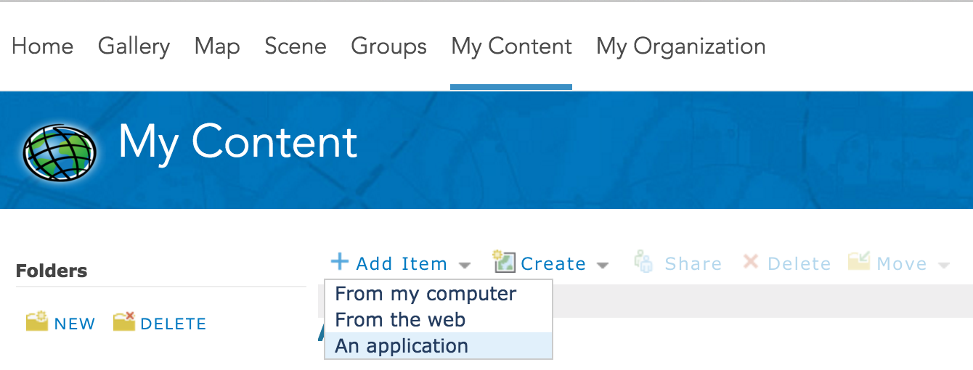
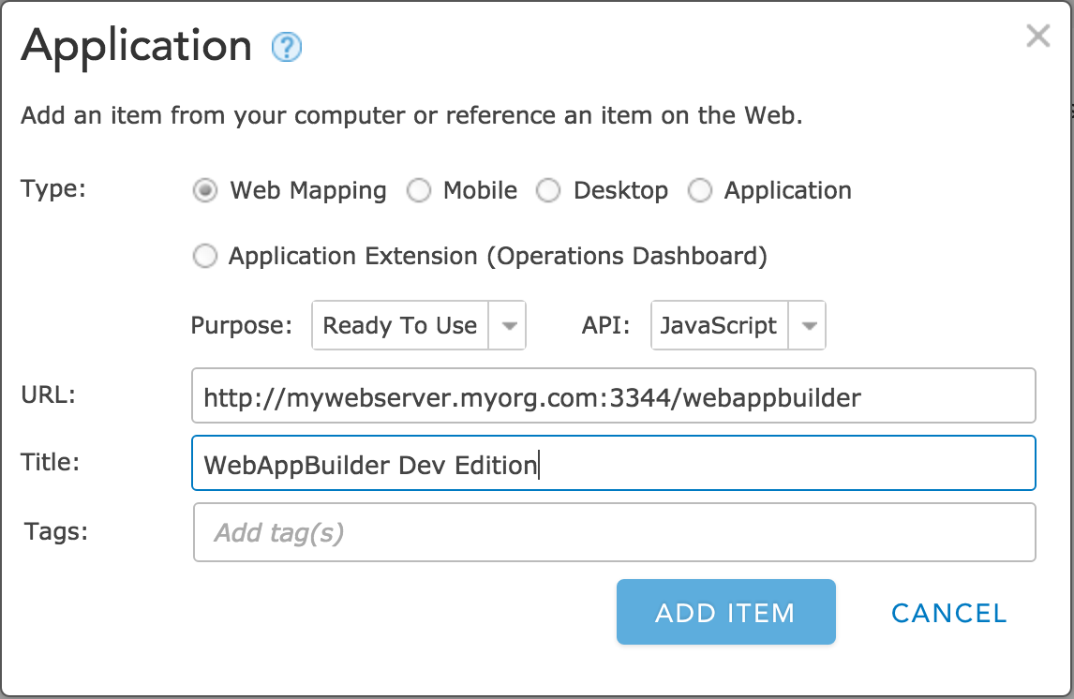
Install/Config Tips
Adding your app to your portal
Notes:
After you have webappbuilder up and running, add it to your organization so users can access this.
Sign in to your Portal/AGOL.
Go to My Content > Add an Item > An Application
Keep default Application options.
Enter the URL where WebAppBuilder lives, give it a title and tags, and Add Item.

Slide 11
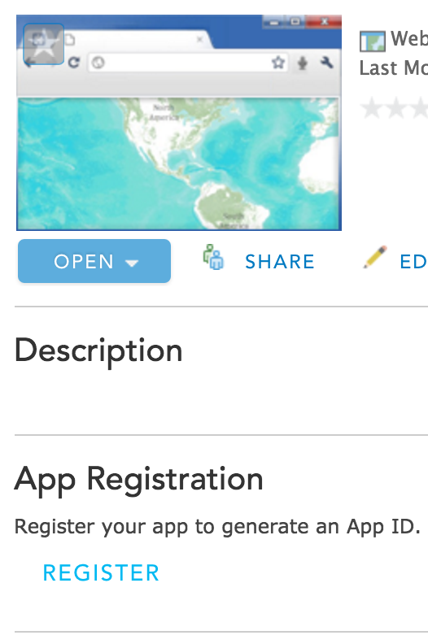
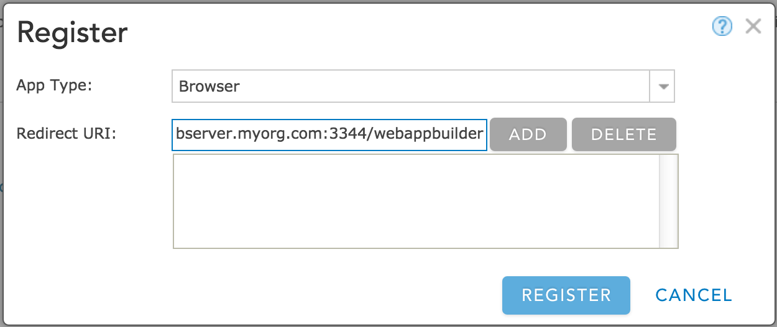
Install/Config Tips
Registering your app (not necessary on web-tier-authenticated portals)
registration popup
item page
Notes:
For Portals and AGOLs using Integrated Windows Authentication, this step should be skipped.
The authentication is happening at the web tier, and as such WebAppBuilder does not need an Oauth AppId.
But for the rest of you, you need an appid before webappbuilder will run.
The item page will open.
App Registration > Register
Add the app location as the redirect uri. Ports are important and need to be included (can't be wild-carded). Same with protocols. Just to be safe, enter http:// and https:// of all addresses.

Slide 12
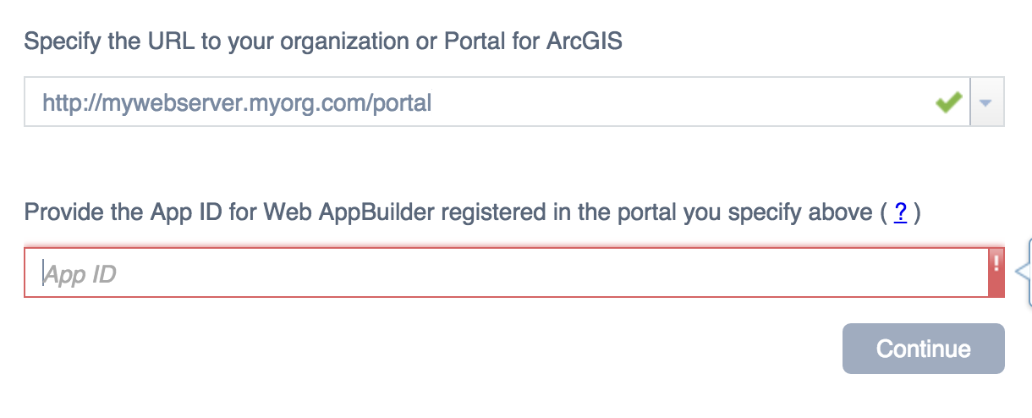
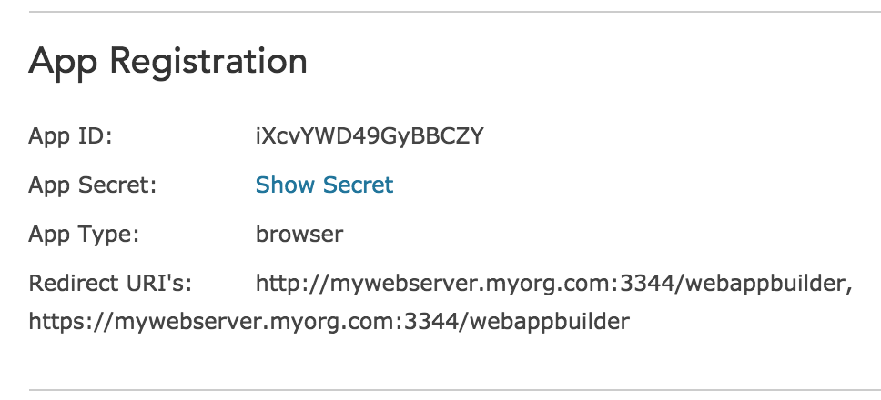
Install/Config Tips
Web AppBuilder
Using AppID for OAuth
server/signininfo.json
[{
"portalUrl": "http://[webserver]/[webadaptor]",
"appId": "iXcvYWD49GyBBCZY",
"supportsOAuth": true,
"isWebTier": false
}]
item page updated
Notes:
The first time WebAppBuilder is opened, if you're not using web tier auth, it will ask for an AppID. Copy and paste the AppID from the item page.
If you need to reset or change the app registration in the future, you can edit this information directoy in server/signininfo.json.
There is an entry for every Portal that has been used with this WebAppBuilder.
If you change from non-web-tier to web-tier later on, you need to go in and actually change these settings.
If your portal is Web Tier authentication, isWebTier should (obviously) be false, and there shouldn't be an appId.

Slide 13
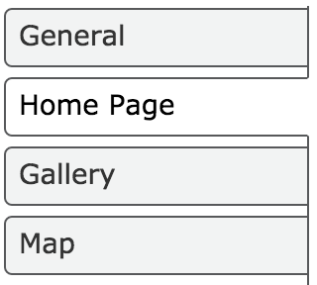
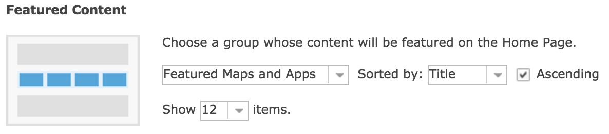
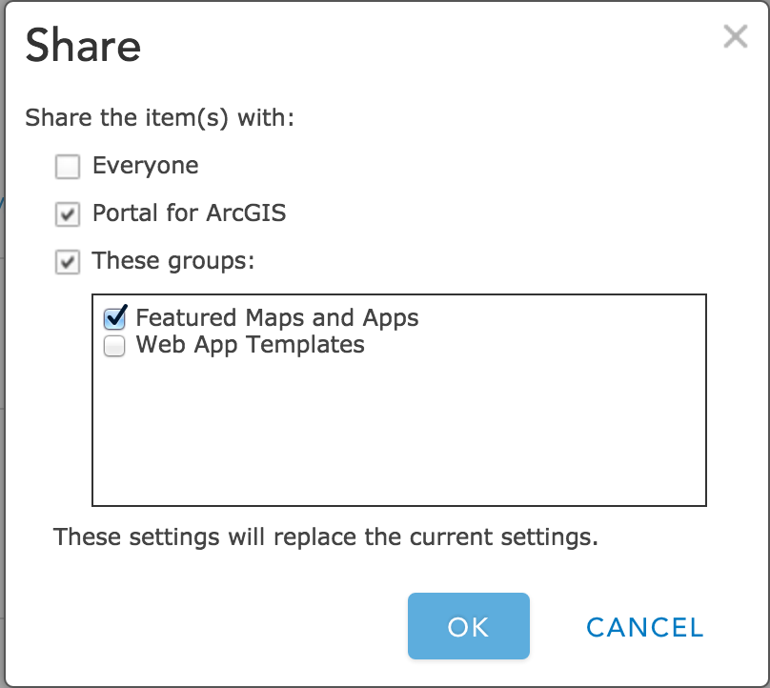
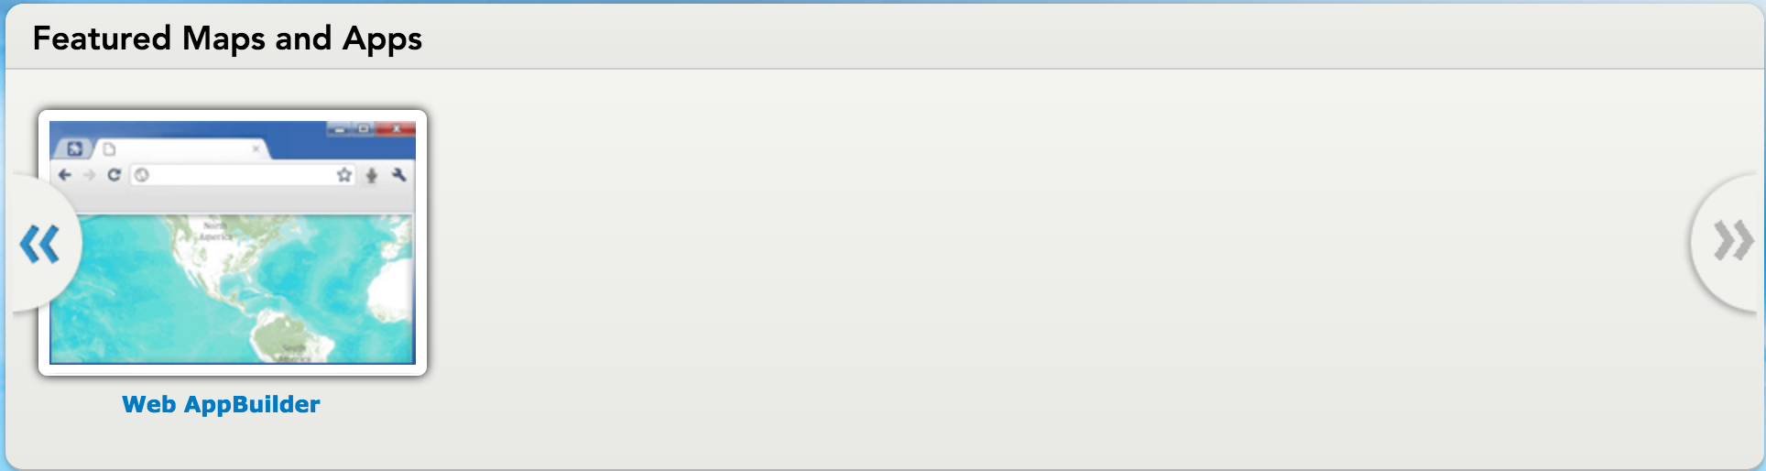
Install/Config Tips
Sharing with your organization
My Organization > Settings
Home page
Item page > Share
Notes:
To put Web AppBuilder on your portal's home page, share the item with the "Featured Maps and Apps" group.
(Enable ths ribbon of maps and apps from My Organization > Edit Settings > Home > Featured Content)

Slide 14

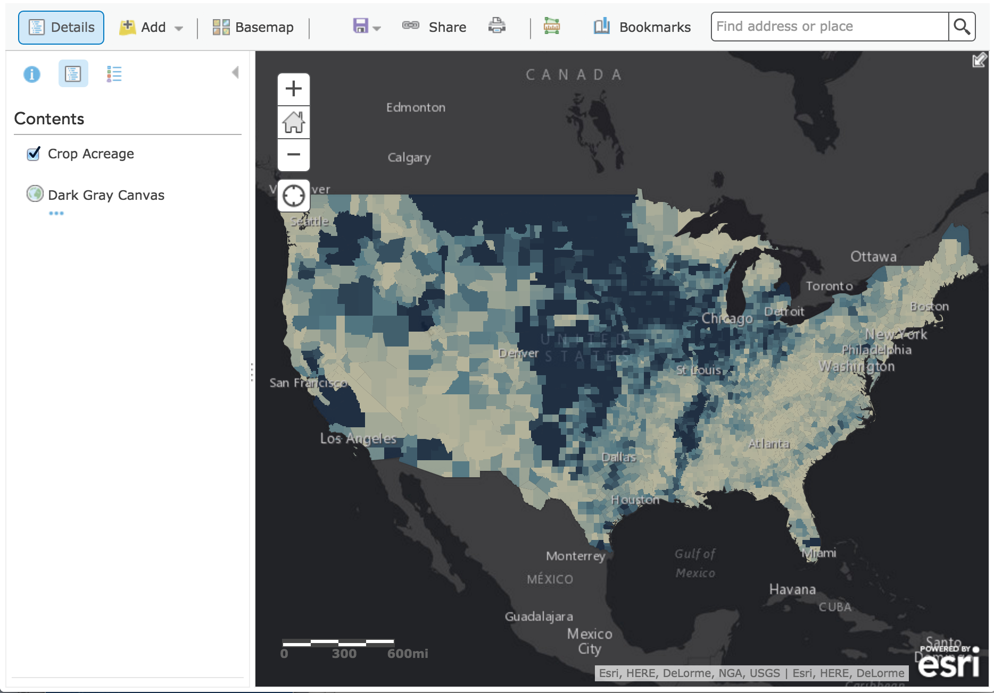
Disabling embedded Web AppBuilder
Notes:
So now that you've got your custom webappbuilder, which is where all your awesome custom themes and widgets will live…
you don't want your users going to the embedded wab because they're not going to find all your awesomeness.
This will take the place of slides 15-17 if we have internet and connectivity to our sample portal.

Slide 15
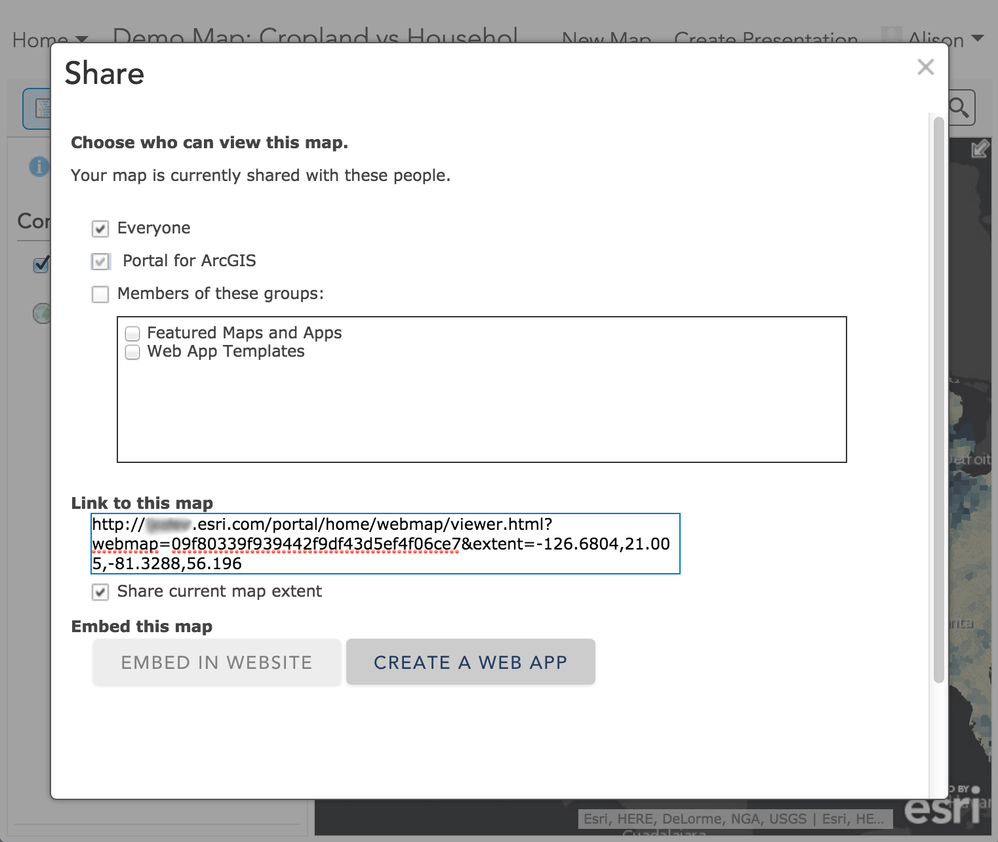
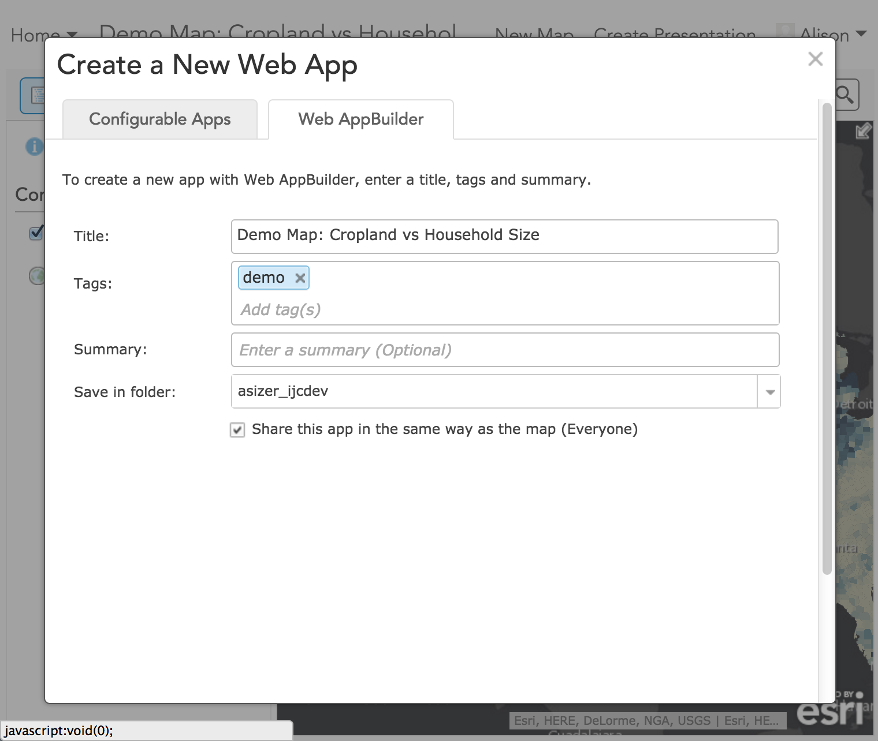
Disable the embedded Web AppBuilder
Portal only (not ArcGIS Online)
webmap > Save > Share
Create a Web App > Web AppBuilder tab
Notes:
ArcGIS Online and Portal come with an embedded version of WebAppBuilder.
Workflow: Create and save a webmap > Share > Create a Web App > Web AppBuilder.
This embedded version doesn't officially support custom themes or widgets, and now that you have a centralized builder that will house all your org's custom themes and widgets, you may not want your users creating apps from this embedded version.

Slide 16
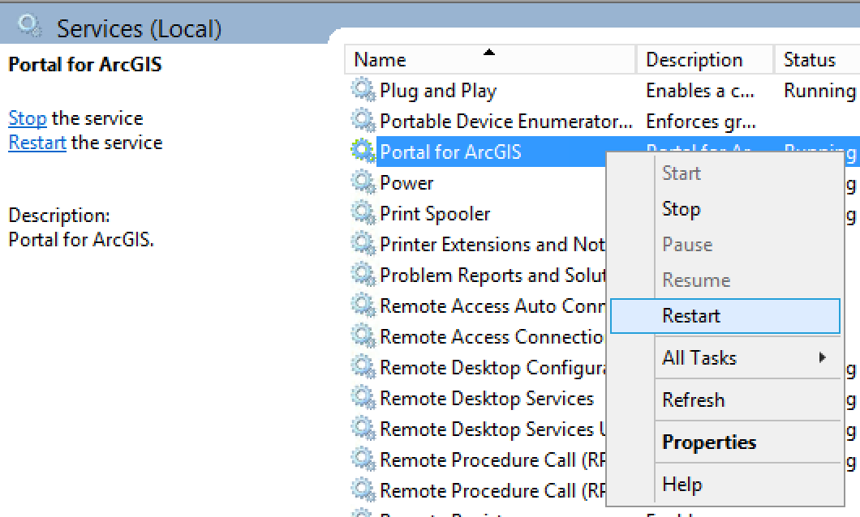
Disable the embedded Web AppBuilder
Portal only (not ArcGIS Online)
C:\Program Files\ArcGIS\Portal\customizations\
10.4\webapps\arcgis#home\js\arcgisonline\config.json
. . .
manageLicensesEnabled: true,
findFeaturesWebMapEnabled: true,
webAppBuilderEnabled: false,
webAppBuilderDownload: true,
sceneViewerEnabled: true,
restrictOrganizationPageToAdmin: false,
. . .
Restart Portal Service
Notes:
Find the config file at the path above, then find the "webAppBuilderEnabled" variable. Change it to false.
Go to Services and restart the Portal for ArcGIS service. (This may take a minute or two).

Slide 17
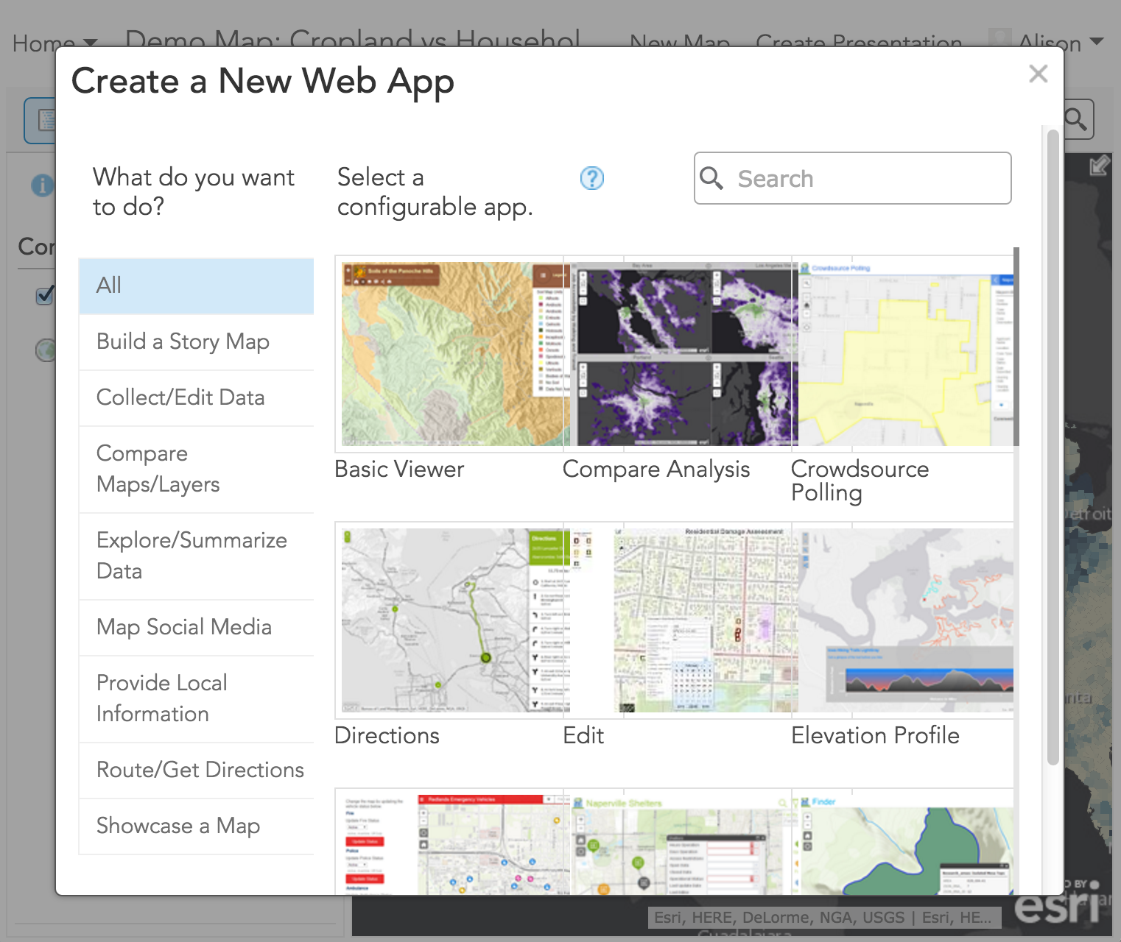
Disable the embedded Web AppBuilder
Portal only (not ArcGIS Online)
webmap > Save > Share
Create a Web App > no more Web AppBuilder tab
Notes:
Go back to your webmap, reload the page, and try sharing again.
Users will no longer see the option to use the embedded WebAppBuilder.

Slide 18

Avoid the https:
Use Your Certificates
Notes:
As developers or enterprise architects, it’s important to try to remove any barriers to access that may prevent large-scale adoption of any given app
For WAB implementations that work with HTTPS enabled web GIS portals and servers, we want to avoid the scary invalid certificate errors

Slide 19


Using Web AppBuilder in HTTPS
WAB ships with a self-signed cert
Not ideal for enterprise users
You can use your own certificate and replace
Domain or third-party CA cert
Server certificate and key pair
Create .pem files
Convert .pfx certificate into a certificate/key pair
Replace cacert.pem and cakey.pem in \server
Restart WAB
Notes:
SL: Show process of requesting Certificate from AD with Subject Alternate Name (so https://slibby10 AND https://slibby10.esri.com both work)
WAB has self signed cert. Not a problem when developing on your own machine. BIG problem when app authors access WAB across the network
Bounce the service

Slide 20
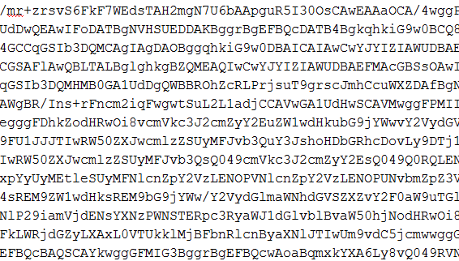
Updating the WAB certificate
Notes:
Let’s look at those steps in a little more detail
There are a lot of different approaches to creating certificate/key pair files from a domain cert.
WAB documentation will steer you towards openssl and node. But since I don’t spend a lot of time in command prompt day to day, I’m gonna show you how to complete the workflow with an opensource program called keystore explorer
Transition to Alison showing WAB embedded being disabled

Slide 21
Develop
custom widgets and themes
Notes:
Nick to present this section
Maybe add: some practices for the project that Nick is working on – extending existing WAB widgets, inherit from the base widget and overwrite the functionality, looking at how to support upgrading without a full rewrite of the widget.
Go back and show how WAB is no longer available in Portal!

Slide 22
App Building process
apps/3
Where your files go
stemapp
configs
your repo
jimu.js
jimu.js
themes
grunt task
app creation
libs
libs
widgets
in Builder
themes
themes
widgets
widgets
config.json
Notes:
The ideal setup for webappbuilder development is to separate your custom components (usually themes and widgets) into their own repository so you can more easily put them under source control without all the clutter and crazy of stemapp.
You can set up a grunt watch task that will sync your repo files with the corresponding folders in stemapp.
When an app is created in Builder, it copies the current state of all the files it needs from stemapp (usually one theme and a subset of the widgets), along with generated config.json files for all the configured widgets and the app itself. (This current state thing is why development is a little problematic…)
Note: if you remove a widget from an app, save the app, then add the widget back again, the widget will reflect the new current state of the code base at the time you added the widget back again.

Slide 23
Developing against stemapp
apps/3
(the easier way)
stemapp
configs
your repo
jimu.js
jimu.js
themes
grunt task
libs
app creation
libs
widgets
themes
in Builder
themes
widgets
widgets
myconfig.json
config.json
myconfig.json
Notes:
One way to shortcut the app development process and avoid creating a bunch of apps until you know your widget or theme is in a good place is to develop against stemapp using a custom config file.
This way, you’ll have a separate environment in which to write your code (your repo) and you can get your custom components stable in an app setting before you try them in Builder.

Slide 24
Developing against stemapp
urls
:3344/webappbuilder/stemapp?config=myconfig.json
Notes:
So the way you do this is to specify a different config in the config url parameter.
stemapp takes a config URL parameter for easy testing of different widget, layout, or color setups.

Slide 25
Extending WAB Widgets
When out of the box widgets are close but need more
Out of the box widgets provide a lot of flexibility but sometimes more customization is needed.
One option is to start modifying the out of the box widget directly.
Alternatively you can use the out of the box widget as a base class and extend it.
Depending on the complexity of the modifications you need to make extending may not be the best option. Need to evaluate on a case-by-case basis.
Notes:
The out of the box widgets provided a lot of flexibility to account for a many user needs though modifying their configuration files. Sometimes this is not quite enough. Users are really good at coming up with things not previously considered.
This tip applies to the situations where the out of the box widget provides the large majority of the needed functionality but additional tweaks or added functionality is required.
Consider the following scenario. A customer likes the way the search widgets works but also wants to allow their users to search for coordinate locations using that same search widget. They want the available coordinate formats to be decimal degrees, degrees, minutes, seconds, UTM, and MGRS. When a coordinate is found they want the map to zoom to that coordinate draw a marker at the location, and display a popup showing details. They also want a help UI to display some information about the coordinate formats so they users can see example inputs.
We could do this by directly modifying the out of the box search widget. We’d make our modifications and place our modified version of that widget under our source control. The problem with this is that moving to the next version of WAB gets a bit tricky. You’ll need to re-apply your changes to the new, updated, search widget.
An alternative is to extend the out of the box widget by creating a new widget and inheriting from the widget you want to modify. This should help when upgrading to a new version of WAB, unless of course the base widget you extend from has completely changed. Then you’ve got to do work in either case.

Slide 26


Extending WAB Widgets
When out of the box widgets are close but need more
Search
SearchEnhanced
Set parent widget as the base widget for new class.
Add any additional properties or methods to the extended widget
Override base methods to call new methods injecting in new functionality.
Notes:
Our strategy is to extend the search widget using is as a parent class for our enhanced version of the widget.

Slide 27
Extending WAB Widgets
When out of the box widgets are close but need more
Let’s look at some code
Notes:
Our strategy is to extend the search widget using is as a parent class for our enhanced version of the widget.

Slide 28
Code Beyond Widgets
Handling common code shared between widgets
There are times when you have code that many widgets will need to access.
You can utilize the libs folder for this purpose
If your widget reference code in libs you won’t be able to as easily share the widget. Both the widget folder and libs will need to be shared
Grunt / Gulp can be used to help with this.

Slide 29
Deploy
created apps

Slide 30
I Have an App!
Now what?
Notes:
So, you’ve got users across your org creating cool apps. What’s next? How do those apps get pushed out to others?
The answer is – it depends

Slide 31
Deployment Scenarios
Embedded Versions
EASY! No deployment needed
WAB Apps Used as Templates
Deployed through the portal
Hosted within WAB (not ideal)
Dev Edition WAB
Manual deployment required
Fits within existing enterprise framework
Notes:
What type of enterprise deployment you’ve chosen affects what that deployment workflow looks like
Embedded versions (AGOL or Portal)
No hassle
The platform does it for you
Users author the apps, which are automatically stored in Portal or AGOL as items. Users can then control who those apps are shared to.
WAB Apps used as templates
This is a capability we haven’t discussed much this afternoon but is possible with WAB
A WAB “template” can be created and shared into portal or AGOL as a starting point for your app authors
The Good
At that point, the web GIS portal treats the app deployment in the same way it does with embedded apps – an item is created and users are in control of the sharing
The Bad
That app lives within WAB’s node js server. So any access or security being handled by your web server are bypassed
Apps created in Dev Edition
Great if you want full control
Keeps all source code contained so affords you the opportunity to deploy to any web server in your environment
BUT that deployment becomes a very manual process that will likely require multiple roles within org

Slide 32
Deploying WAB Apps
Download
Deploy
Register
(re)Configure
App Author or Developer
Sys Admin
App Author or Developer
Developer
Notes:
So if you’re an org that is leveraging WAB dev edition at a broader enterprise level, it will be absolutely critical to have a workflow and procedures in place to help guide deployment
HIGH LEVEL
Follow these steps and these steps will likely be performed by different individuals within org
Download the app
Deploy to a web server
Configure proxy (optional)
Register the app with Portal – makes it easier for people in org to discover and access the app
Configure the AppID – optional, but required if you want to take advantage of OAuth

Slide 33
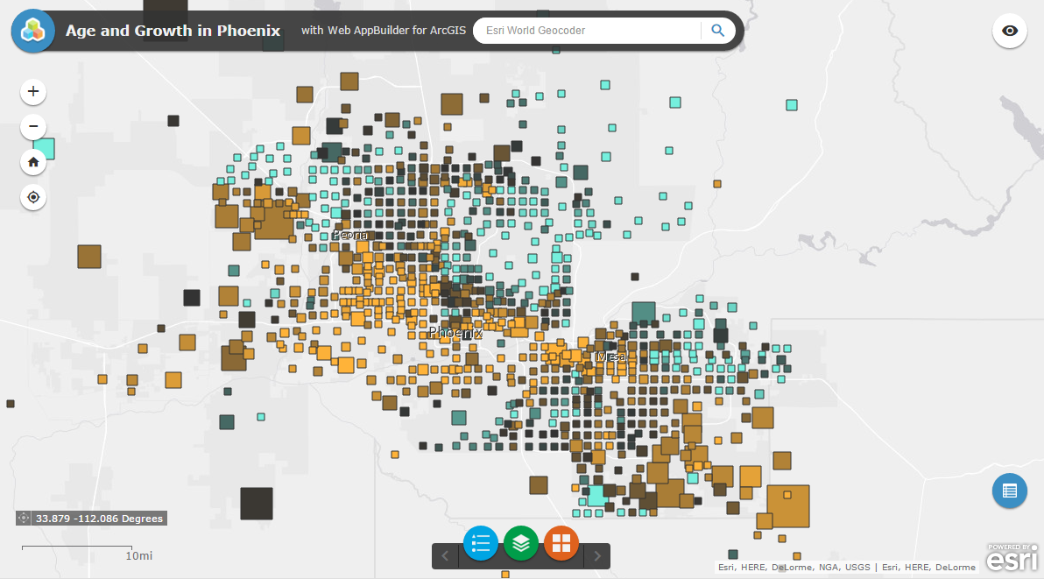
Deploying the app
Notes:
Ben

Slide 34
Post-Deployment
What happens next?

Slide 35
Proxies
Notes:
Sam to cover Proxy topic

Slide 36
Proxies
Usages
Cross-Domain Resources
Token-based secured resources
OAuth 2.0 app logins
Referer
limiting
Rate limiting
Notes:
There are a number of reasons you may want to use a proxy with a WebAppBuilder app:
Access Cross-Domain Resources
Access token-based secured resources
Oauth 2.0 app logins
Rate limiting

Slide 37
Proxies
Find on Github
https://github.com/esri/resource-proxy/
Java
.NET
php
Notes:
Esri publishes three different proxy versions on github. Find the version that works for your server, download it, and install it somewhere on your web server.

Slide 38
Proxies
Access a secured webmap
[downloaded-app]/config.json
. . .
"httpProxy": {
"useProxy": true,
"alwaysUseProxy": false,
"url": "",
"rules": [{
"urlPrefix": "http://yourwebserver/yourwebadaptor/sharing/rest",
"proxyUrl": "http://yourproxyfolder/proxy.php"
}]
}
. . .
Notes:
Download your app, deploy to your web server, and register it as an item in your portal.
Navigate to its config.json file. Find the httpProxy section and add a rules object.

Slide 39
Proxies
Access a secured webmap
[proxy-folder]/proxy.config
<serverUrls>
<serverUrl
url="http://services.arcgisonline.com"
matchAll="true"
/>
<serverUrl
url="http://webserver/webadaptor/sharing/rest"
matchAll="true"
clientid="xxxyyy12345"
clientsecret="aaabbbccc987654321"
oauth2Endpoint="https://webserver/webadaptor/
sharing/rest/oauth2/token"
/>
</serverUrls>
Notes:
Add server rule to your proxy.config file with the registered app's id and secret, and the oathtokenservice.

Slide 40
Using a proxy to access protected resources
Notes:
1. Show the Demo Map is only shared to the organization
2. Launch org's web appbuilder and create a new app with th

Slide 41
Thank you!
Any Questions?
Alison Sizer
asizer@esri.com
github.com/asizer
Ben Schaub
bschaub@esri.com
Please rate this session in the Esri Events mobile app!

Slide 42




